Slide 1
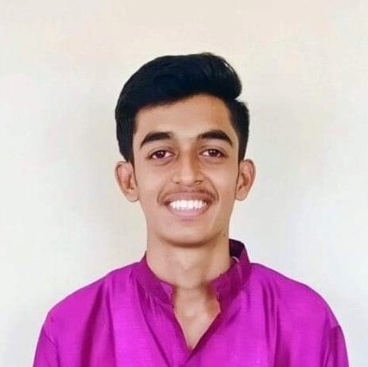



Pratik Gupta
Analyst/Software Engineer
Bachelor of Engineering
Electrical Engineering: 2018 - 2022
Skills
Mumbai
Java 11 | Java Basics, OOPS, Generics, Collections, Arrays, Loops, Lambda Exp, Stream API Junit, Mockito, Servlets
Spring core | IOC & Dependency Injection, Autowire
Spring REST | REST controllers, Implementation of GET, POST, PUT & DELETE, Bean Validation & Exception Handling, Testing Services, Controller & Repository layer
Spring Data JPA | Implement DAO layer using spring Data repositories, Transaction Management
Spring Boot Microservices | Spring Boot Starters, annotations, Messaging Service - Rabbit MQ,Swagger API documents
Spring Cloud | Eureka & Config Server
Angular | Components, Services, Modules, Routing, Forms & Validation, Testing using Jasmine & Karma
Database | MongoDB, My SQL
UI Tech | HTML 5 & CSS,,JavaScript, Optimized UI Designed
Tools | Git, Postman, Maven,Intellij Idea IDE
Add On skills | Communications, Team management. Peer learning
pratik.b.gupta@capgemini.com
+91 9479350937
A4 Analyst
Full Stack Developer
Java Full Stack (MongoDB, AngularJS) developer
Hands on experience in creating Microservices with Spring boot, Spring Security, Spring Cloud API Gateway, Eureka server, load balancing
Proficient in creating Single page Web Application in Angular with Authentication with route guards, Angular reactive forms, angular routing, Tailwind CSS
Hands on experience in implementing polyglot architecture with Angular & spring boot
Experience in creating documentation with swagger and in unit testing using Junit, Mockito.
Railway Reservation System
Completed end to end case study of Railway Reservation Application along with JWT authentication, Swagger and payment testing using Stripe, responsive UI with CSS and Angular used for user interface.
Completed Introduction to Machine Learning an online non-credit course authorized by Duke University and offered through Coursera.
Completed eight weeks online training on Programming with C and C++ through Internshala.
AWS Cloud Practitioner Certified
UI/UX Design – Working on Figma
Check out my work on GitHub & Video Profile

